Slide 1
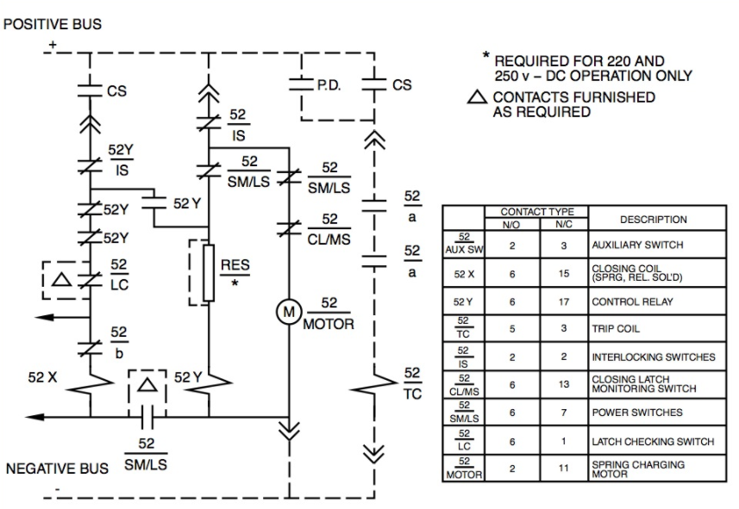

Slide 2
NOTE: EQUIPMENT VENDOR PO NUMBER 12.3456
NEGATIVE BUS

